Slide 1
dn/dc a gateway parameter
also known as Specific Refractive Index Increment (s.r.i.i.)
sometimes given the symbol ν (probably a bad symbol choice)
n = refractive index (unitless)
c = polymer concentration (g/mL)
dn/dc has units of mL/g

Slide 2
Why dn/dc matters
We use it to get molecular weight of polymers
That molecular weight impacts strength, elasticity, processibility
We combine molecular weight with molecular size to get an idea of polymer shape.
Almost everything we know about polymers hinges on dn/dc!

Slide 3
Learning objectives
How to make proper solutions.
Work with a really precise instrument.
Establish proper plotting etiquette.
Linear fits
Error propagation

Slide 4
The famous Zimm plot that gives us absolute molecular weight and sometimes size and virial coefficients is based on thermodynamics.
First, we introduce the Rayleigh factor, R.
R =
You have my permission to slap anyone who calls it Rayleigh ratio.
The purpose of the Rayleigh factor is to “take out” the uninteresting dependencies on V (detected volume of solution) and r² ( r = distance from particle to detector). For a dipole radiator, I_{s} goes down with squared distance to the detector, r², so multiply that back in; I_{s} goes up with detected volume, so divide that out.

Slide 5
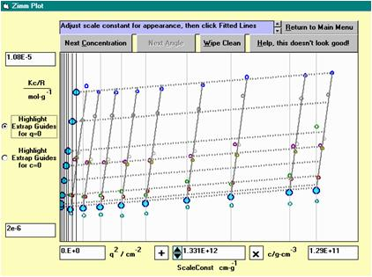
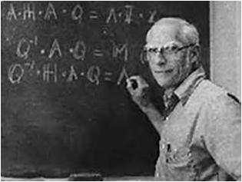
Using our Rayleigh factor and replacing the proportionality with optical parameters, we get Zimm’s famous equation:
R is the gas constant here.
T is the Kelvin temperature.
K is called the optical constant.
M is the molecular weight.
A₂ is the virial coefficient
R_{g} is the radius of gyration
n_{o} = refractive index
N = Avogadro’s number
We maintain a whole web article about Zimm plots, associated with our program, GuiDe.
https://www.appliedpolymertechnology.org/uploads/1/0/8/8/108867241/guide.doc
Backup: http://macro.lsu.edu/howto/guide/guide.doc
The Zimm part of it this document actually in the appendix, because strictly following Zimm’s procedure is no longer beneficial or needed. (Zimm invented his plot because he did not have computers or computer graphing!) You can download GuiDe, install, and practice Zimm plots using real data.
Bruno Zimm
Polystyrene in toluene, an easy case.
Notes:
Now, R is like intensity, and you can see it is in the denominator with M, so I~M as we said already. We are doing an inverse plot. So inverse intensity rises with angle q. And then there is the virial coefficient correction.

Slide 6
Even though no one follows Zimm’s exact procedure to analyze light scattering data anymore, the plot is more than a polymer science icon: it tells a lot about the sample!
Zimm plots combine (by a scaled addition) both independent parameters—the angle and the concentration—on the x-axis, reserving the z-axis for Kc/R (or just c/R sometimes).
These points represent an extrapolation to θ = 0. The slope gives A₂.
These points represent an extrapolation to c = 0. The slope gives R_{g}.
The θ = 0 and c = 0 intercepts should be identical. Combined with optical constant, they give M_{w}.
Each point in the middle is Kc/R for a particular concentration at a particular angle.
Sin²(θ/2) + kc where k is a scaling constant to give concentration the same “importance” in the plot as the angle term, Sin²(θ/2) .
This measurement is
in 97% H₂SO₄…so what’s your toughest solvent?
Poly(ether-etherketone),PEEK, in 97% H₂SO₄. Not so easy.
In both cases, just by looking at the plot, you can see the polymers are quite large and dispersed in good solvents

Slide 7
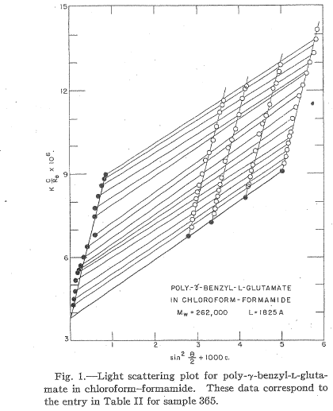
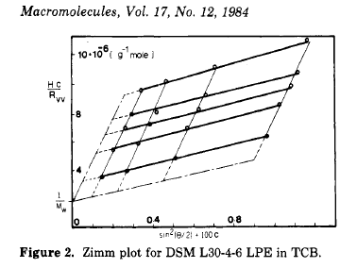
Zimm plots of the rich, famous and obscure.
← Doty, Bradbury & Holtzer, JACS, 1956. Does your Zimm plot look this good?
↑Random web search: what does it tell us?
Notes:
By the way, few people USE Zimm plots anymore to get M, Rg and A2; however, the results from other ways of fitting the equation to the data are sometimes recast along with the data in the form of a Zimm plot because it so conveniently summarizes the polymers characteristics.

Slide 8
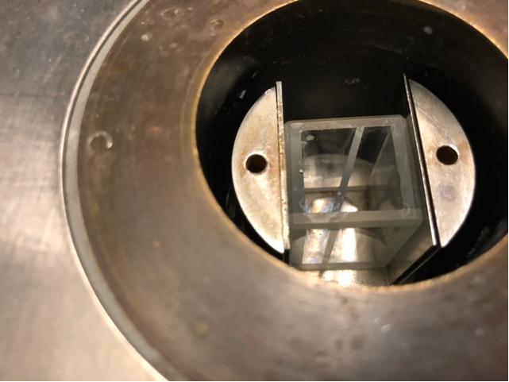
We could measure n vs c directly, but it’s better to measure n_{solution} – n_{solvent} to avoid temperature drift (so how does that work?). Even so, usually the differential refractometer will have good temperature control. In our teaching lab, we sometimes skip good temperature control.
Because the solution is dilute, the temperature dependence of its refractive index is almost the same as that of the solvent. So, compare one against the other and eliminate temperature drift as a practical concern.
In this split cell arrangement, the tiny differences between refractive index of the solution and that of the solvent appear as deflections of light, due to Snell’s law.
The deflections are not really as drawn here, but they are linear in concentration. An electronic position-sensitive detector or optical scale with microscope is used to detect them.
A real split cell, loaded in our marvelous old C.N. Wood instrument.→
http://slideplayer.com/slide/4502695/14/images/32/Differential+Refractive+Index+Detector.jpg

Slide 9
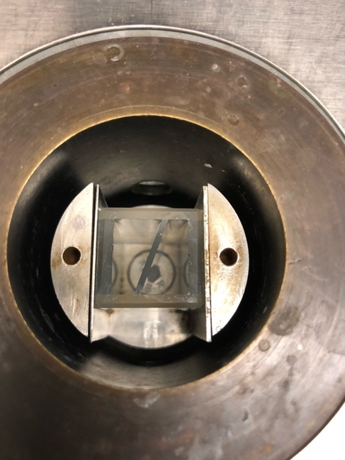
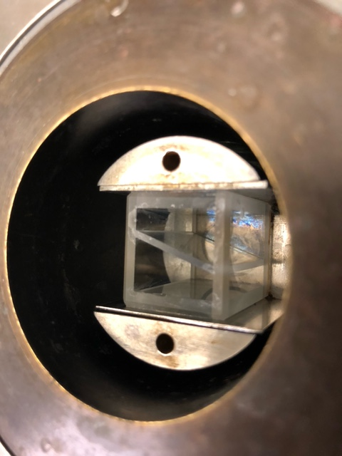
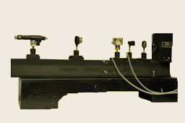
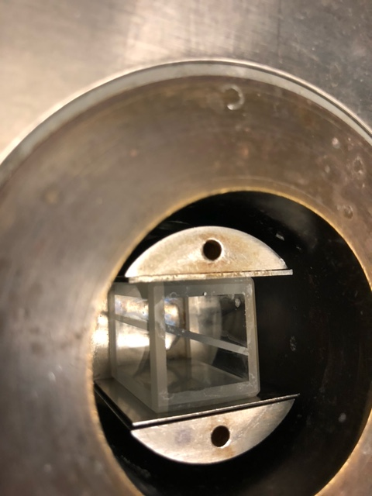
Our C.N. Wood dn/dc instrument is a “shrunken” version of this beast, the famous Brice-Phoenix differential refractometer.
Brice, B. A. and M. Halwer (1951) A Differential Refractometer. J. Optical Soc. Am. 41, 1033-7.
The BP (as it’s called in the HowTo guide document) and its baby sister, the CN Wood that we use, are amazingly precise instruments capable of detecting refractive index differences on the order of 0.0001 or even less.
All you have to do is calibrate them and use them.

Slide 10
What dn/dc is
Unfortunate symbol

Slide 11
How dn/dc instruments work: Snell’s law (n₁sinθ₁ = n₂sinθ₂)
n₁
θ₂
θ₁
n₂
measurable displacement ∝ S
light source &
pinhole or slit
θ_{ext}
split cell: solvent on one side, solution on the other.
Definitions:
S = signal (electronic or visual reading from dial indicator, depending on instrument)
O = offset signal (constant)
V = Value (voltage or visual reading from dial indicator, depending on instrument)
n = refractive index (subscript 1 or 2 for solvent & signal…or vice versa)
θ = angle of beam to surface normal (subscript 1 or 2 for solvent & signal…or vice versa)
θ _{ext} = external angle after further refraction at glass-air interface.

Slide 12
What happens if we rotate the cell by 180º?
Notes:
Answer: the deflection goes the other way, doubling our signal. The Brice-Phoenix and C.N. Wood instruments do this. But….it’s optional if you don’t need the sensitivity.

Slide 13
Two steps: calibrate and measure
Calibrate with KCl (dried) or other salt. In a two-person team, one person could prepare these solutions and do it. In a two-team class, one team could do this, with each person making 2 or 3 solutions.
Measure some simple polymer….e.g., sodium poly(styrene sulfonate). In a two-person team, one person could prepare these solutions and measure. In a two-team class, one team could do this, with each person making 2 or 3 solutions.
Start by measuring water vs water. Measure nothing first! (←our motto!)
Leave water in one side of the cell; add solution to the others.
Always work from low concentrations to high! (Why?)
We are calibrating for slope! Offset errors in Δn or even in Δc are not insurmountable or even worth worrying about.

Slide 14
Calibration stage
← Use to calculate Δn of known KCl solutions during calibration (known c values because you made the solutions, known dn/dc because someone worked that out once).
l_{o}/Å | Light Source, color | dn/dc in mL/g for KCl /H₂O @ 25ºC | dn/dc in mL/g for NaCl /H₂O @ 25ºC
6328 | Helium-neon laser, red | 0.13182 | 0.17010
5890 | Sodium lamp D line, orange | 0.13277 | 0.17138
5145 | Argon ion laser, strongest green | 0.13496 | 0.17435
4880 | Argon ion laser, strongest blue | 0.13599 | 0.17575
← The Δn values come from above equation for various c values of solutions you prepared. You measure S and fit a line to get O and dV/dn.

Slide 15
Measurement stage
← Measure signals for a series of known polymer concentrations; fit O and slope dV/dc.
← Combine calibration and measurement results.

Slide 16
Measure The Weights Precisely!
You need high precision for dn/dc because the number is squared before use; errors are magnified!
So when you weigh out your calibration salt or polymer unknown, use a high-precision balance.
Make a stock solution that is big enough that you can weigh and use 5 significant digits. For example, if you want 0.0015328 grams/mL you cannot prepare just a 1 mL sample! No balance we have measures such tiny masses.
But you can weigh 1.5328 grams into 1000 mL (1-liter) flask. Then dilute by a factor of 1000 (using sufficiently precise pipettors).

Slide 17
Weigh everything on a 4-place or better balance because volume is not very precise.
OK….so you can use volume as a convenient way to deliver and dilute your solutions, but it’s safest to weigh everything.
Example: Dilution by a factor of 100
Step 1. Empty vial or volumetric flask: 10.53289 grams (g)
Step 2. Add “0.100 mL” of stock solution: 10.63108 g (almost 0.1 g heavier)
Step 3. Add “9.90 mL” of water or bring volumetric flask to line: 25.42083 g

Slide 18
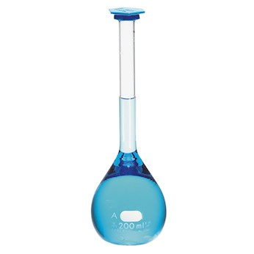
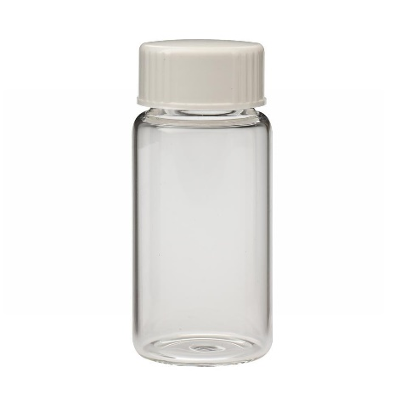
Volumetric flasks or vials?
Volumetric flasks let you add diluent (water) to get the solution to the right volume. No conversions needed. (But still….always weigh at every step!)
Vials are easy, cheap and disposable (no clean-up). But you have to know partial specific volumes of the solute and solvent to convert the masses to concentrations, as described in the Making Solutions HowTo.
You can consider this for the partial MOLAR volumes (convert to partial specific):https://doi.org/10.1016/0016-7037(57)90022-4
For NaPSS this seems like a promising lead:
http://www.tandfonline.com/doi/full/10.1080/00222348.2016.1256182

Slide 19
Grading of the experiment
I will inspect lab notebooks: table of contents, plan of experiment, actual experiment easy to follow, pages signed and dated.
Calibration: plot Δv vs Δn to get calibration constant
Measurement of unknown: plot Δn vs Δc to get dn/dc as slope.
All plots must be labeled correctly.
Final dn/dc value must have a ± error estimate!

Slide 20
Detailed plan of procedure*
*It is recommended that senior students be challenged to write their own plan of procedure. Beginning students can try this one, not guaranteed to succeed.
Materials: 25 mL volumetric flask with stopper, four (4) 10-mL volumetric flasks, KCl dried in oven or vacuum oven to constant weight, NaPSS polymer or hydroxypropylcellulose, rack of scintillation vials, 4-place balance.
Two-person teams: one does calibration, the other the polymer
Calibration solutions: Make Cmax = ~10 mg/mL stock solution in 25 mL volumetric flask, plus dilutions in 10 mL volumetric flasks
→If 250 mL volumetric uses a ground glass stopper, tape it with Teflon tape or add a sleeve
→weigh volumetric flask on best balance that can manage its weight
→label 4 10-mL volumetrics with Cmax, 0.8Cmax, 0.6Cmax, 0.4Cmax, and 0.2Cmax (alternative: you might use scintillation vials here if you know the KCl partial specific volume)
→fold some weighing paper so it can serve as a funnel
→weigh ~250 mg KCl to at least 4-place precision on weighing paper
→pour weighed KCl into 25 mL volumetric flask
→chase any remaining powder off the weigh paper into flask with a gentle stream of best-available water (distilled or water system)
→add more clean water until the volumetric flask is about 25% full…enough for easy swirling; swirl into KCl has dissolved
→add more water → swirl→add→swirl→add until water is in the thin “neck” of the flask; look for striations in fluid to disappear as you swirl
→warm or cool the flask and pure water to the final desired temperature
→slowly add water until you hit the meniscus line
→Invert volumetric SLOWLY to ensure complete mixing
→Repeat inversion 24 times. Yes, 24. I mean it…it is hard to make homogenize a solution
→Weigh the volumetric (including stopper and tape)
→Deliver 8, 6, 4 and 2 mL of stock solutions to the appropriate volumetric flasks
→Weigh
→Bring final volume to 10 mL
→Weigh

Slide 21
Detailed plan of procedure*
Polymer solutions can be made as the calibration ones were, but here we go with an all-weight scheme on the assumption we know partial specific volume (or will measure it later).
Make Cmax = ~10 mg/mL stock solution in scintillation vials, plus dilutions
→dry the polymer in a vacuum oven to constant weight
→label 5 vials Cmax, 0.8 Cmax, 0.6 Cmax, 0.4 Cmax and 0.2 Cmax
→weigh scintillation vial on a balance that can read 0.0001 g or less (caps or no caps….depends on volatility of solvent IMO)
→add 100 mg* polymer to vial #1 (weigh to at least 4 significant figures)
→gather all the powdered polymer into one “edge” at the bottom of the cell by tapping it
→add approx. 1 mL clean water, try to get polymer start to swell
→add approx. 9 mL water
→Cap if not already capped, then vortex mix
→Weigh to check for leaks or sticky stuff on glass from vortex mixer
→Repeat for 80, 60, 40 and 20 mg to get the 0.8, 0.6, 0.4 and 0.2Cmax solutions
→Give polymers at least overnight time to dissolve SLOWLY to ensure complete mixing; check occasionally and mix as needed
*Do not waste time trying to get exactly 100 mg! Be happy with anything from 90 mg to 110 mg. The important thing is to know the weight to as many significant figures as the balance will permit.

